Slide 1


Academy
Python Testing 101
Anthony McKale Principal Engineer
15/05/2021

Slide 2
Python Testing Basics
Today we’ll cover :
Test Theory
Python Linting Tool
Python Security Dependency Testing
Python Security code Testing
Python Unit Testing Tool
Worked Example
It’ll aim to cover black, pipaudit, semgrep, unittest and pytest python tools
https://docs.python.org/3/library/unittest.html
https://docs.pytest.org/en/6.2.x/ https://black.readthedocs.io/en/stable/#

Slide 3
Test Theory

Slide 4
Python : Test Theory
History
Software Test Types
Why Test ?

Slide 5
Very Brief Software Testing History

Slide 6
Python : Test Theory History Lesson
First there was chaos (im)

Slide 7
Python : Test Theory History Lesson
1970 – Waterfall created: start of modern software Introduced Manual Testing as a common place practice In 80’s also added automated System integration as well though default was still manual testing …
1995 – Agile manifesto published: start of common place testing
pushed for smaller faster unit testing as standard process to ensure quality
2010 – Software Supply Chain attacks

Slide 8
Python : Test Theory History Lesson
1970 – start of modern software (Waterfall created) “Quality control”
Integration Testing: Reactively checking and meeting quality requirements Also common place best practice and linting
1995 – start of common place testing (Agile manifesto published)
“Quality assurance”
Unit Testing: Proactively ensuring processes and product correct as being made
Will come back to this…

Slide 9
Python : Test Theory History Lesson
List non exhaustive :
field has grown, with new test approaches such as:
Behaviour Driven Development (Integration Test Driven)
Test Driven Development (Unit test Driven)
These are advanced topics, day is about basic implementation not approach

Slide 10
Python : Test Theory History Lesson
Questions ?

Slide 11
Software Test Types

Slide 12
Python : Software Test Types
Manual Debugging on dev machine by programmers, not covered by this talk
Manual E2E with Test Scripts on deployed Application by qa, not covered by this talk
Automated Unit by programmers, i/o testing of functions
Automated E2e by qa/programmers, testing full deployed application

Slide 13
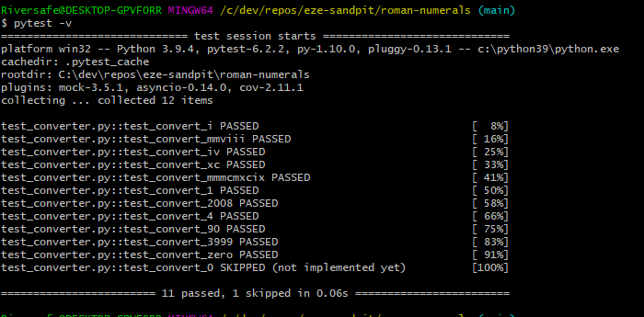
Python : Unit Testing Given / When / Test at small scale
Cliffnotes
Write actual code in source language, next to code
Run code to assert expectation
Profit
This is slower and hard to do, especially if done retrospectively
Done well, you know what, why & where something is bust and broken
https://en.wikipedia.org/wiki/Cucumber_(software)
https://www.selenium.dev/documentation/en/webdriver/
https://cucumber.io/docs/gherkin/

Slide 14
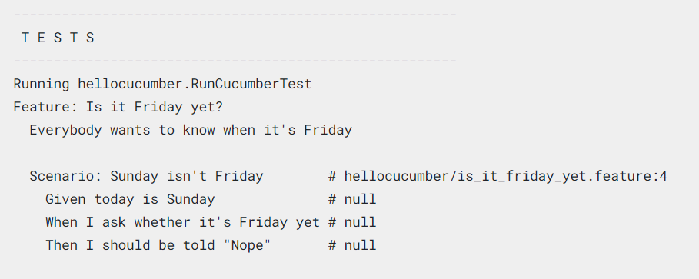
Python : E2e Testing Given / When / Test at big scale
Cliffnotes
Write pseudo code* in pseudo English
Regex pseudo English into Code
Profit
Works well with well defined requirements, it’s super quick to get e2e testing created
It’s undetailed, knows something is broken not where, what or how
* Ps: folks sometimes write integration tests directly in sugared code instead of gherkin
https://en.wikipedia.org/wiki/Cucumber_(software)
https://www.selenium.dev/documentation/en/webdriver/
https://cucumber.io/docs/gherkin/

Slide 15
Why Test ?

Slide 16

Python : Test Theory Why ? History Lesson
Most famous Software Bug
Boeing Delta II 1998
https://en.wikipedia.org/wiki/Mars_Climate_Orbiter

Slide 17
Python : Test Theory Why ? History Lesson
Most famous Software Bug
Boeing Delta II 1998
System A: gave pounds of force required for lift off
https://en.wikipedia.org/wiki/Mars_Climate_Orbiter

Slide 18
Python : Test Theory Why ? History Lesson
Most famous Software Bug
Boeing Delta II 1998
System A: gave pounds of force required for lift off
System B: required newtons per sq meter for lift off
https://en.wikipedia.org/wiki/Mars_Climate_Orbiter

Slide 19
Python : Test Theory Why ? History Lesson
Most famous Software Bug
Boeing Delta II 1998
System A: gave pounds of force required for lift off
System B: required newtons per sq meter for lift off
When A and B spoke the Rocket blew up at a total cost of $327 million
https://en.wikipedia.org/wiki/Mars_Climate_Orbiter

Slide 20
Python : Test Theory Why ? History Lesson
This is a lesson why proper testing is needed before things go Live!
System A and B needed Unit, integration, and manual testing
Even Nasa can occasionally mess up
https://en.wikipedia.org/wiki/Mars_Climate_Orbiter

Slide 21
Python : Test Theory Why ? History Lesson
How do you know which systems to test ?
https://en.wikipedia.org/wiki/Mars_Climate_Orbiter

Slide 22
Python : Test Theory Why ? History Lesson
How do you know which A and B will blow up your app ?
Dirty Secret: You don’t*¹
You need to test everything*² to be semi sure*³
https://en.wikipedia.org/wiki/Mars_Climate_Orbiter

Slide 23
Python : Test Theory Why ? History Lesson
How do you know which A and B will blow up your app ?
Dirty Secret: You don’t*¹
*¹ Complexity, previous impacting bug locations can help
https://en.wikipedia.org/wiki/Mars_Climate_Orbiter

Slide 24
Python : Test Theory Why ? History Lesson
You need to test everything*² to be semi sure*³
*² Conventionally you aim for a percentage of everything called coverage
*³ Another dirty secret, testing code can have bugs…
https://en.wikipedia.org/wiki/Mars_Climate_Orbiter

Slide 25
Python : Test Theory Why ? History Lesson
How do you know which A and B will blow up your app ?
Dirty Secret: You don’t*¹
You need to test everything*² to be semi sure*³
*¹ Complexity, previous impacting bug locations can help
*² Conventionally it’s a percentage of everything called coverage
*³ Another dirty secret, testing code can have bugs…
https://en.wikipedia.org/wiki/Mars_Climate_Orbiter

Slide 26
Questions?: Test Theory
Questions ?

Slide 27
Python Unit Testing

Slide 28
Python Unit Testing
Python Unit Testing 101
Extra Stuff

Slide 29
Python Unit Testing 101

Slide 30
Python Unit Testing 101
Basic Terms
- Test Assertion : A check for a condition
- Test Case : Grouping of setup code then Test Assertions (Unit test case: would be for single function)
Test Suite : Grouping of Test Cases
- Test Framework/Runner : Software App that runs your tests suite

Slide 31
Python Unit Testing 101 Test Framework/Runner
Software App that runs your tests suite
Python has two main runners:
Unittest inbuilt, a bit basic https://docs.python.org/3/library/unittest.html
Pytest installed via pip, very advanced, has lots of plugins, built ontop of unittest https://docs.pytest.org/en/6.2.x/
We’ll be covering pytest, but basically they both work the same way

Slide 32
Python Unit Testing 101 Pytest Test Runner
basically easy to install and use
Install via pip “pip install pytest”
create a folder called tests/
Have files in there with the name “test_<module_name>”
Run with “pytest tests”

Slide 33
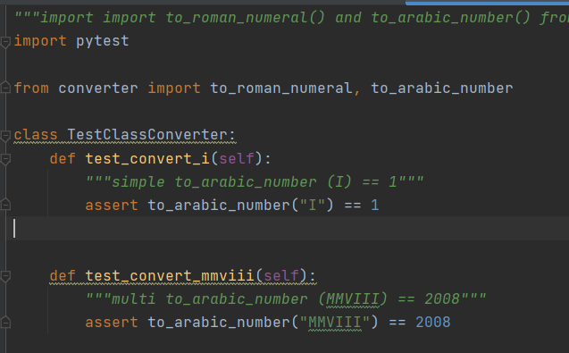
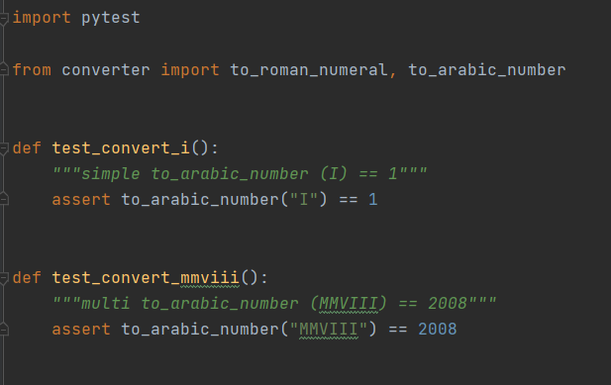
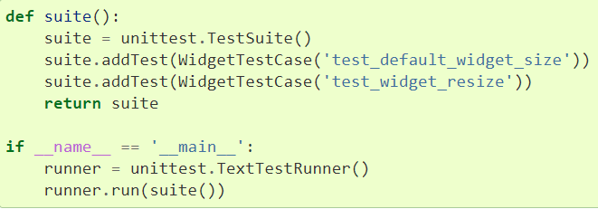
Python Unit Testing 101 Pytest Test Suite
basically it’s a file, either :
- Class prefixed “Test…” with functions prefixed “test_”
- or a File prefixed “test_” with functions prefixed “test_...”
- can be created via code but that’s mad (not teaching it)

Slide 34
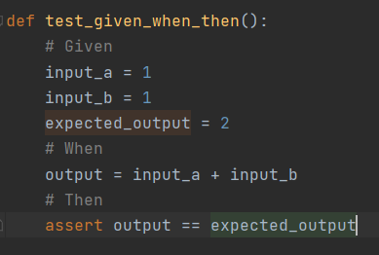
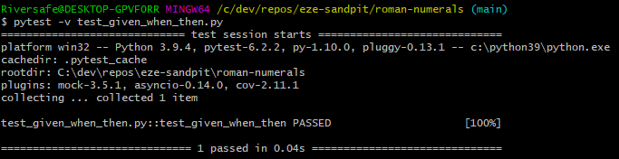
Python Unit Testing 101 Pytest Test Case
Grouping of setup code then Test Assertions (Unit test case: would be for single function)
Normal layout is :
Given
non tested setup
- When
get function under test output
- Then
expectations

Slide 35
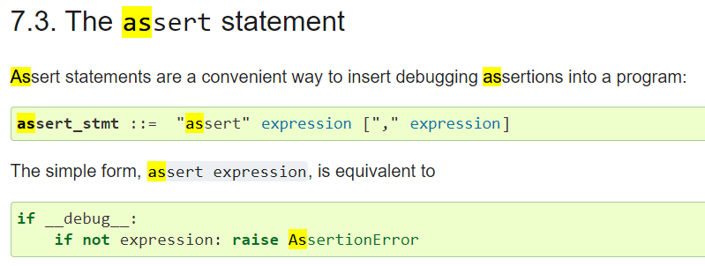
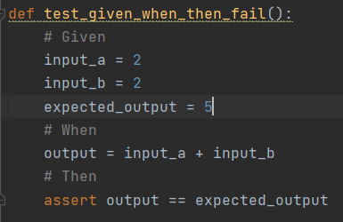

Python Unit Testing 101 Pytest Test Assertion
A check for a condition
assert
It’s a very cool python operator Effectively it’s checks for equality other wise
raises a exception caught by the framework
https://docs.python.org/3/reference/simple_stmts.html#the-assert-statement

Slide 36
Python Unit Testing 101 Summary
As I was saying…

Slide 37
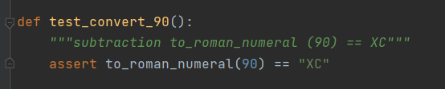
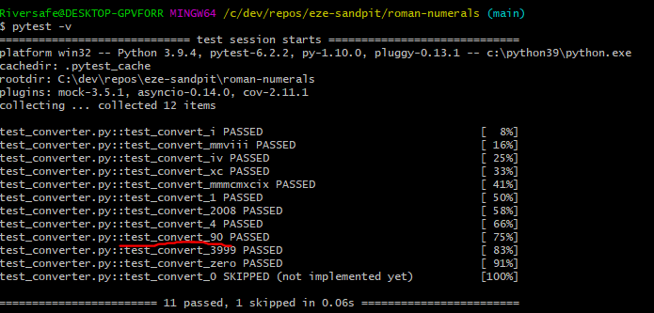
Python Unit Testing 101 Summary Given / When / Test at small scale
Unit Testing
1) Write actual code in source language
2) Run code to assert expectations
3) Profit
This is slower and hard to do retrospectively
Done well, you know what/why/where is bust and broken
https://en.wikipedia.org/wiki/Cucumber_(software)
https://www.selenium.dev/documentation/en/webdriver/
https://cucumber.io/docs/gherkin/

Slide 38
Python Unit Testing Extra Stuff

Slide 39
Python Unit Testing Extra
Will now talk about :
Mocking
Fixtures
Snapshots
Setup / Teardown
Coverage

Slide 40
Python Unit Testing Extra Mocking
Mocking is basically creating a known replacement for testing to talk to
Some examples :
environment variables can be “mocked” so the test can run against given environment
Classes can be “mocked” to given consistent / known output
HTTP calls can be “mocked” to ensure consistent responses and not cause expense or slowness

Slide 41
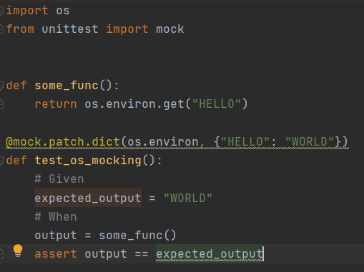
Python Unit Testing Extra Mocking Worked Example
Pytest environment variables Mocking Example
Using “unittest.mock.patch”*
* Remember pytest built on unittest

Slide 42
Python Unit Testing Extra Fixtures
Some times you really want to insert a big xml file or image file or something into a test Inserting it inline is really messy, especially if it needs to be reused
The answer is Fixtures, common input into tests in a neat and tidy way
https://docs.pytest.org/en/6.2.x/fixture.html

Slide 43
Python Unit Testing Extra Snapshots Example
Some times you really want to compare the output to a big xml file or image file or something into a test Copy and pasting the HTML output or image file into a test, is messy and hard to update
The answer is Snapshot plugin, common output checking into tests in a neat and tidy way*
* Note: snapshot tests are normally not really unit tests but integration tests, but they’re still very very useful
https://pypi.org/project/pytest-snapshot/

Slide 44
Python Unit Testing Extra Snapshots Example
pip install pytest-snapshot
use magic “snapshot”
Run with pytest with --snapshot-update to create initial snapshot
Run with pytest with --snapshot-update to update snapshot, if they need to change
And you can even use git’s diff to tell the differences ! ☺
https://pypi.org/project/pytest-snapshot/

Slide 45
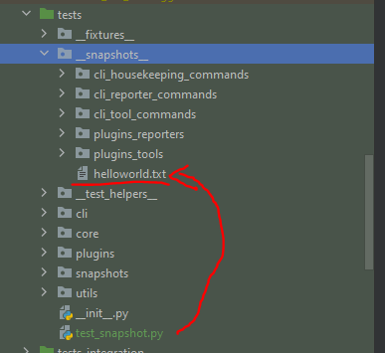
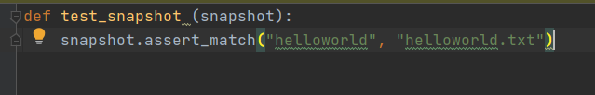
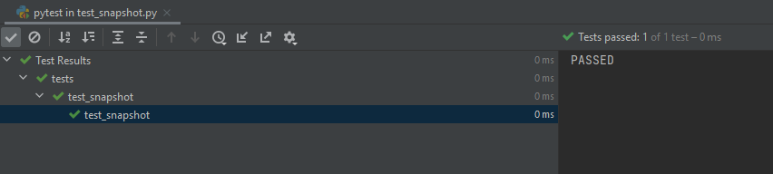
Python Unit Testing Extra Snapshots Example
Once installed use magic “snapshot”
parameter
https://pypi.org/project/pytest-snapshot/

Slide 46
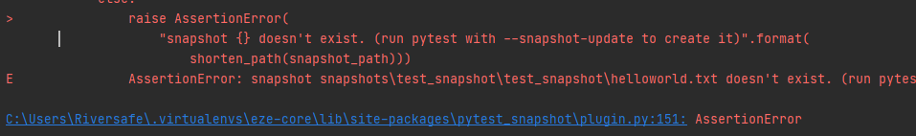
Python Unit Testing Extra Snapshots Example
WARNING: remember to run pytest with --snapshot-update to generate or update snapshots!
Or it’ll fail with this Assertion Error
https://pypi.org/project/pytest-snapshot/

Slide 47
Python Unit Testing Extra Setup/ Teardown
Sometimes you want to setup common stuff before tests And destroy or restore stuff afterwards
Pytest has some handy hooks for this ☺
(ps all the inbuilt mocking and fixtures will do this automatically)
https://docs.pytest.org/en/6.2.x/xunit_setup.html

Slide 48
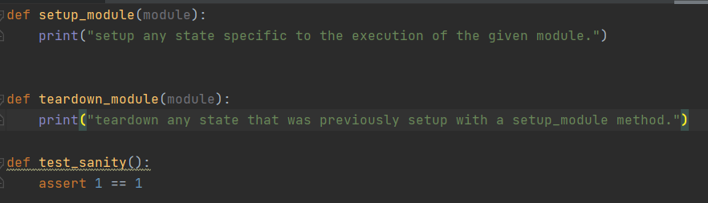
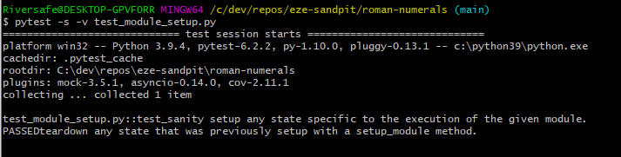
Setup/ Teardown Module (File) Test Suites
Use setup_module and teardown_module

Slide 49
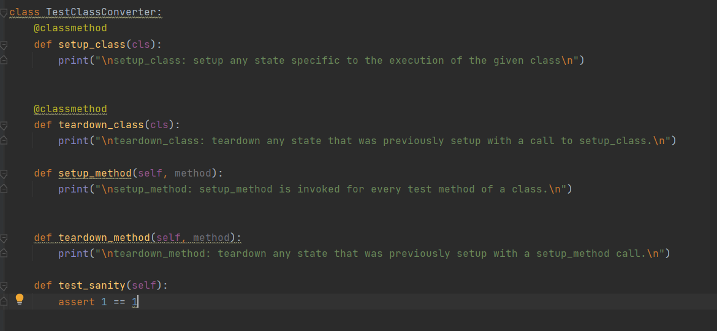
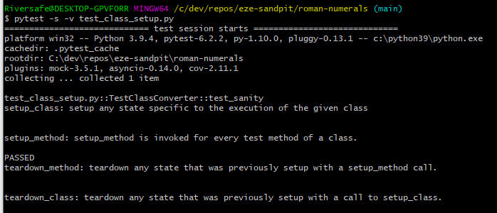
Setup/ Teardown Class Test Suites
Use setup_class and teardown_class for test suite level User setup_method and teardown_method for test case level

Slide 50
Coverage
How do you know which lines of code are tested ? How do you get that as a percentage ?
Or find the functions with logic hidden behind nested if statements that aren’t being executed during your tests ?
Pytest (& code coverage) to the rescue

Slide 51
Coverage
Coverage is a advanced topic but …
basically add this to your pytest command, and you’ll get it all
pytest tests -vv --cov=eze --cov-branch --cov-report=term-missing --cov-report html:reports/coverage/cov_html --cov-report=xml:reports/coverage/coverage.xml

Slide 52
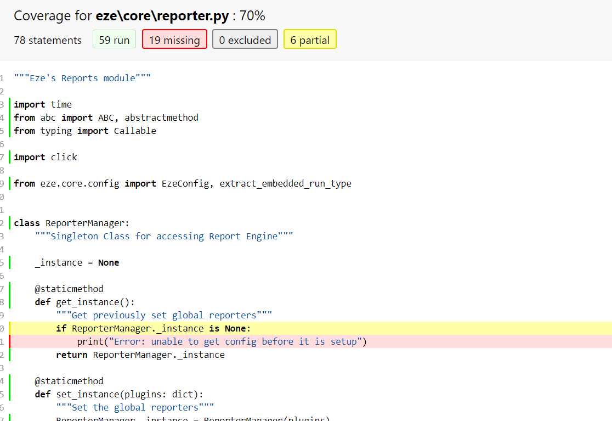
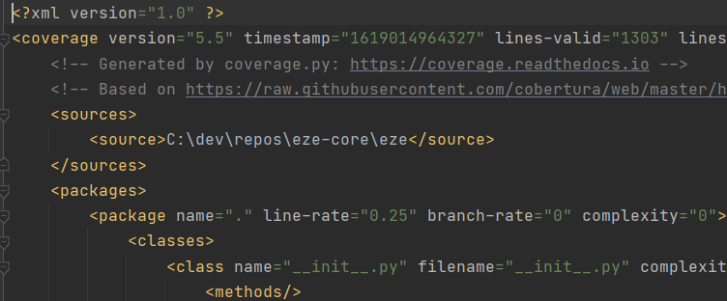
Coverage
Aka: Gives you pretty html for humans, and a cover file for CI servers

Slide 53
Python Unit Testing
Questions ?

Slide 54
Further
Reading

Slide 55
Further Testing Read:
here’s some further reading
Documentation for Python Testing
https://docs.python.org/3/library/unittest.html
https://docs.pytest.org/en/6.2.x/
https://docs.pytest.org/en/6.2.x/xunit_setup.html History of Testing http://www.testingreferences.com/testinghistory.php

Slide 56
Questions
I’ve been Anthony M^{c}Kale “Wizard without Portfolio” Fixer-Upper of Broken things, and creator of time-constrained workable Fudges for 21 years. Email : anthony@zapper.hodgers.com

Slide 57
Thank
you

